Slide 1
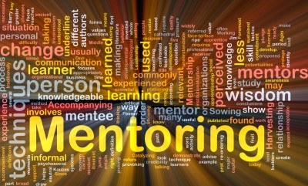
The Key to Finding a Great Mentor: Be a Great Mentee!
Roger B. Fillingim, PhD
Distinguished Professor, College of Dentistry
Director, Pain Research and Intervention Center of Excellence
Director, CTSI Mentor Academy
University of Florida

Slide 2
I Wish My Mentor Knew…
what it means to be a mentor
that sometimes we both need to sit together to interpret my results and google is not my mentor, she is!!
the importance of being transparent
that I need to feel like I belong in science
that the color of my skin does not determine the quality of my work!
www.nrmn.net

Slide 3
Overview
What is mentorship and why is it important?
Qualities of good mentors & mentees
Characteristics of good mentor-mentee relationships
What you can do to make your mentor better

Slide 4
What Are You Looking for from a Mentor?

Slide 5
The Story of Mentor
In Homer’s Odyssey, Odysseus entrusted the care of his household and his son (Telemachus) to Mentor.
Thus, the term evolved to mean trusted advisor, friend and teacher.

Slide 6
What Is Mentorship
Mentorship is a professional, working alliance in which individuals work together over time to support the personal and professional growth, development, and success of the relational partners through the provision of career and psychosocial support.
National Academies of Sciences, Engineering, and Medicine 2019. The Science of Effective Mentorship in STEMM. Washington, DC: The National Academies Press.

Slide 7
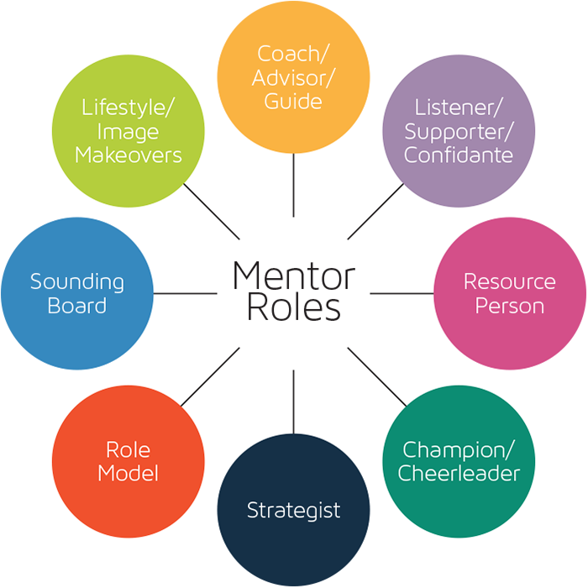
Mentors perform multiple functions
Boss

Slide 8
Why is mentorship important

Slide 9
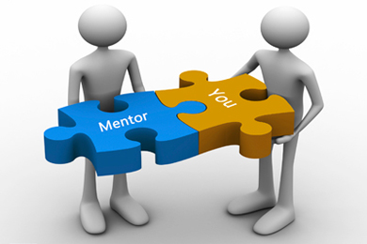
If you want one year of prosperity, grow grain
If you want ten years of prosperity, grow trees
If you want one hundred years of prosperity, grow people.
- Chinese proverb

Slide 10
Benefits of Mentoring in PhD Programs (Molloca & Nemeth, 2014 Am J Educ Res 9: 703-708)
Mentoring showed beneficial effects on:
Student socialization
Scholarship
Research productivity
Career commitment
Self-efficacy
Attrition
Graduation

Slide 11
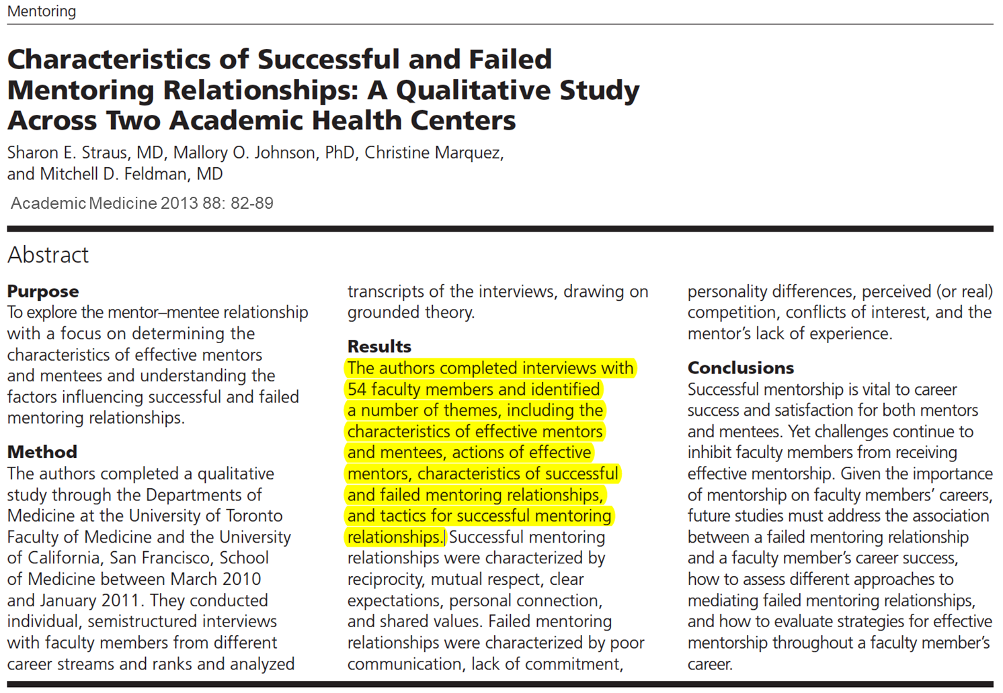
What are the Qualities of a Good Mentor?

Slide 12
Characteristics of Effective Mentors (Straus, et al, 2013, Acad Med, 88: 82-89)
Altruistic
Honest/trustworthy
Active listeners
Experienced in mentoring
Professional experience & networks
Accessible
Able to identify mentees’ strengths & weaknesses

Slide 13
CBE-Life Sciences Education, December 1, 2019
Absence of Positive Mentoring Experiences | Failure to Engage in Mentoring Best Practices | Actively Harmful Mentoring Experiences
Interpersonal mismatch | Absenteeism | Abuse of power
Lack of career support | Misaligned expectations | Unequal treatment
Lack of psychosocial support

Slide 14
Actions of Effective Mentors (Straus, et al., 2013, Acad Med, 88: 82-89)
Providing Career Guidance
Offer Emotional Support
Address Work-Life Integration

Slide 15
What’s in It for the Mentor?
Tenure & Promotion
Productivity
Intellectual Energy
Personal Satisfaction
Immortality

Slide 16
What are the Characteristics of a Good Mentee?

Slide 17
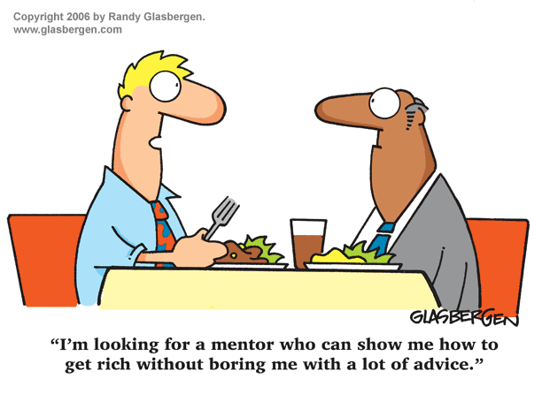

Slide 18
Characteristics of Effective Mentees (Straus, et al, 2013, Acad Med, 88: 82-89)
Open to feedback
Active listeners
Responsibility
Take responsibility for driving
the relationship
Paying attention to timelines
Respectful of mentor
Be prepared for meetings
Recognize other demands
on mentor’s time

Slide 19
What Do Good Mentees Do?
Communicate
Be Proactive
Bring Structure
Use the Time
Bring Energy
Follow Through
Listen & Respond

Slide 20
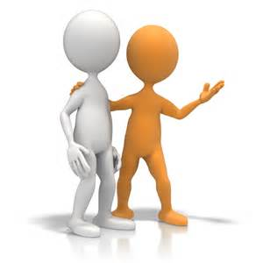
Characteristics of Successful Mentoring Relationships (Straus, et al, 2013, Acad Med, 88: 82-89)
Reciprocity
Mutual Respect
Clear Expectations
Personal Connection
Shared Values

Slide 21
Communication and Mentoring
Communication is the most potent active ingredient in the mentoring relationship.
While effective communication will not guarantee a successful mentoring relationship, poor communication will guarantee failure.

Slide 22
Mehrabian’s 7-38-55 Rule

Slide 23
Process of Communication
Information Source
Transmitter
Signal
Filtering
Channel
Receiver
Destination

Slide 24
Misaligned Expectations
Vague or unstated expectations
Unclear roles & responsibilities
Failure to tailor expectations
Changes in expectations over time

Slide 25
At Least Two Sets of Expectations
Performance & Training Expectations
Expectations about the Relationship
Scholarly Productivity
Reaching milestones
Time management
Performance in the lab
Completing training activities
Progression toward independence
Nature and goals of the relationship
Frequency of meetings
How meeting time should be used
Mentee & mentor roles
Open communication
Grounds for separation

Slide 26
Individual Development Plans (IDPs)
http://myidp.sciencecareers.org
Mentor-Mentee Compacts

Slide 27
Mentor-Mentee Matches
Endowments
Knowledge
Experience
Preferences
Communication Style
Learning Mode
Content
Connections
Values
Research Training
Techniques
Leadership/Professionalism
Content Adapted from Dr. Laura Lunsford

Slide 28
Finding a Research Mentor
“Arranged marriages” are not optimal
Content expertise
Resources to support your work
Do a test drive (i.e., lab rotations)
Talk to other mentees
Talk to other faculty
Aligned goals & expectations
Personal match
Build a mentoring network

Slide 29
Making Your Mentor Better
Drive the relationship
Be prepared for meetings
Be proactive
Communicate
Shared expectations
Request feedback
Path to independence
Concerns about the relationship

Slide 30
Summary
Mentorship is grounded in a relationship
Good mentors and mentees have specific qualities
Communication and alignment of expectations are critical
You can make your mentor better!

Slide 31
Thank You

