Slide 1
Components of Critical Thinking

Slide 2
Today’s Agenda
You will:
Distinguish the nature of critical thinking from thinking
Analyze components of critical thinking
Think about how you can utilize these tools to build your own capacity for CT

Slide 3
The Mind and Training
The best mind training recognizes natural tendencies and learns to discriminate between what is good and what is not
“A man who does not think for himself does not think at all.” ~Oscar Wilde

Slide 4
The Natural Resources
Funds of material in which to draw upon
Previous experiences, “stored” information
Promptness, Flexibility, and Fertility
Quick alternatives which can develop
Order and appropriateness
Fitting pieces together in a relevant and timely manner

Slide 5
What is Thinking?
“Thinking is any mental activity that helps formulate or solve a problem, make a decision, or fulfill a desire to understand. It is a search for answers, a reaching for meaning” (Ruggerio)
“What we think, we become.”
~Buddha

Slide 6
Intellectual Traits
Humility
Courage
Empathy
Autonomy
Integrity
Perseverance
Confidence in Reason
Fair Mindedness

Slide 7
Tomato, Tamato…
Inquisitiveness
Open-mindedness
Systematicity
Analyticity
Truth-Seeking
Self-Confidence
Maturity
Intellectual humility
Intellectual courage
Intellectual empathy
Intellectual integrity
Intellectual perseverance
Faith in reason
Fairmindedness

Slide 8
Becoming a Critic

Slide 9
What does it mean to be a critical thinker?

Slide 10
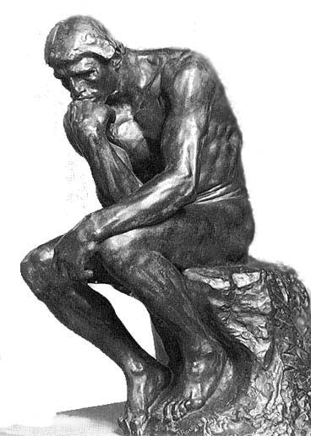
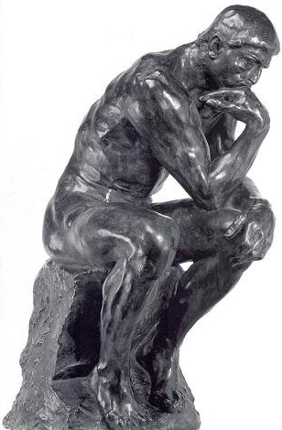

Slide 11
What is Critical Thinking?
Reasoned, purposive, and reflective thinking used to make decisions, solve problems, and master concepts
(Rudd, Baker, Hoover, 2000)

Slide 12
Clue 1 – It’s All About the Qs
Asking good questions
Answering questions with good reasoning
Believing the results of your own good reasoning
Acting on the results of your reasoning

Slide 13
Critical Thinking
Dispositions
Engagement
Cognitive Maturity
Innovativeness
Styles
Engagement
Seeking
Skills
Interpretation
Analysis
Evaluation
Inference
Explanation
Self-Regulation
“How do I know what I think until I see what I say?” ~E. M. Forster

Slide 14
CT Skills
Interpretation
Categorization
Clarifying meaning
Decoding significance
Analysis
Examining ideas
Analyzing arguments
Analyzing assumptions
EVALUATION
Assessing claims
Assessing arguments
Assigning value

Slide 15
CT Skills
Interpretation
What is this?
Where does this information “Fit?”
How does this relate to what I already know?
Why is this important?
Categorization
Clarifying meaning
Decoding significance
Analysis
Examining ideas
Analyzing arguments
Analyzing assumptions
EVALUATION
Assessing claims
Assessing arguments
Assigning value

Slide 16
CT Skills
Interpretation
What is this?
Where does this information “Fit?”
How does this relate to what I already know?
Why is this important?
Categorization
Clarifying meaning
Decoding significance
Analysis
What is the point?
What is the issue or position?
What are the assumptions?
What evidence or information supports the position?
What is the line of thinking?
Examining ideas
Analyzing arguments
Analyzing assumptions
EVALUATION
Assessing claims
Assessing arguments
Assigning value

Slide 17
CT Skills
Interpretation
What is this?
Where does this information “Fit?”
How does this relate to what I already know?
Why is this important?
Categorization
Clarifying meaning
Decoding significance
Analysis
What is the point?
What is the issue or position?
What are the assumptions?
What evidence or information supports the position?
What is the line of thinking?
Examining ideas
Analyzing arguments
Analyzing assumptions
EVALUATION
Clear
Accurate
Precise
Relevant
Depth
Breadth
Logic
Assessing claims
Assessing arguments
Assigning value

Slide 19
CT Skills
Explanation
Stating results
Justifying procedures
Presenting arguments
Inference
Finding alternatives
Drawing conclusions
Making recommendations

Slide 20
CT Skills
Explanation
State your position
Defend your position
Support points with information and evidence
Support points with valid assumptions
Re-state your position
Stating results
Justifying procedures
Presenting arguments
Inference
Finding alternatives
Drawing conclusions
Making recommendations

Slide 21
CT Skills
Explanation
State your position
Defend your position
Support points with information and evidence
Support points with valid assumptions
Re-state your position
Stating results
Justifying procedures
Presenting arguments
Inference
Recognizing that problems have a range of solutions and that decisions fall along a range from better to worse.
Project a range of potential consequences for alternatives.
Finding alternatives
Drawing conclusions
Making recommendations

Slide 23
Self-Regulation
CT Skills
Self examination: Stopping to ask yourself important questions about your beliefs
Self correction: Changing your beliefs if it is warranted

Slide 24
Self-Regulation
CT Skills
Self examination: Stopping to ask yourself important questions about your beliefs
Self correction: Changing your beliefs if it is warranted
What is my belief?
Why do I believe this to be true?
What evidence of information do I have?
Can I justify my belief with evidence and information?
If yes, continue to hold this belief.
If no, question my belief and search for more information.
I may need to change what I believe…

Slide 25
Putting it together
Dispositions, Styles, and Skills are are necessarily to build capacity for CT
There are LOTS of different ways to sort out CT and what is important
Use tools that you are comfortable using

