Slide 1
Self-Advocacy
Dr. Nicole Stedman
Focus on Mentoring

Slide 2
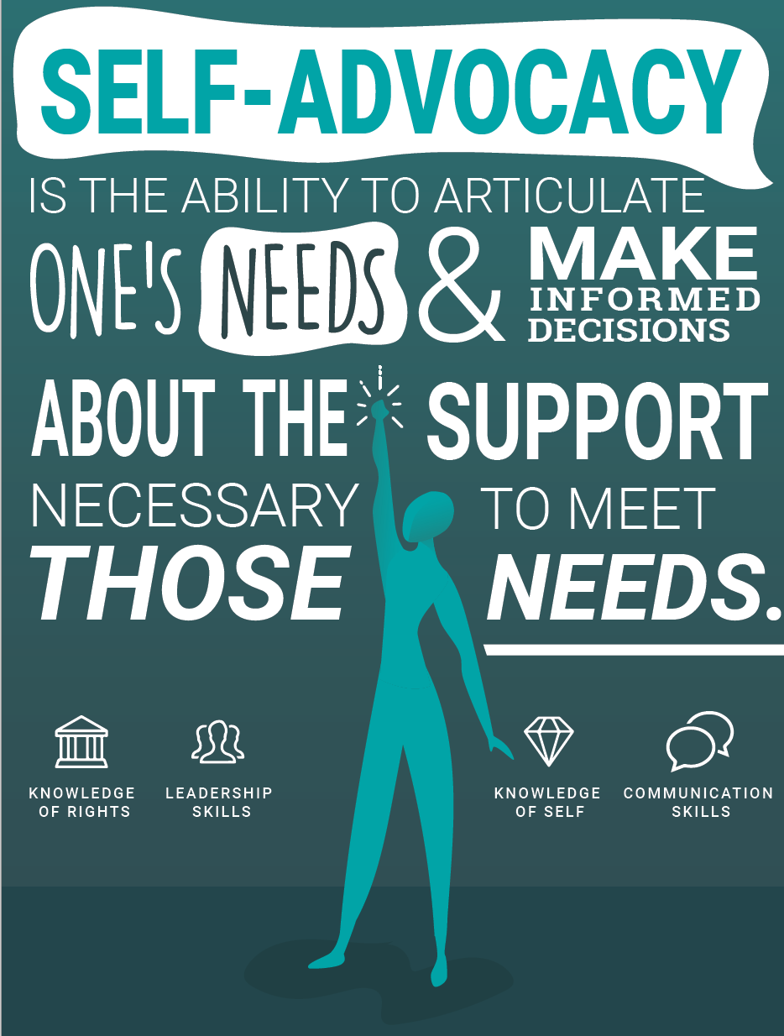
Agenda
Define Self-Advocacy
Identify strategies for developing self-advocacy
Practice self-advocacy

Slide 3
What is Self-Advocacy?
Self-advocacy is the ability to communicate one's needs and wants and to make decisions about the supports needed to achieve them (Stodden, Conway, & Chang, 2003)

Slide 4
Why Self-Advocate
It raises awareness about an issue you and others face
It can support career/experience advancement
It ensures your rights are not violated
It will help decrease stress

Slide 5
Outcomes of Self-Advocacy
Adaptation
Persistence
Academic Performance
How We Get There…
Knowledge of Self
One’s Rights

Slide 6
Learning to Self-Advocate
Families and Educators
General Support
Intentional Teaching
Specific Instructions

Slide 7
Proactive, Reactive, and Retrospective
Proactive
Knowing and anticipating types of support that is needed
Reactive
Seeking support as a result of recognizing a hurdle or challenge
Retrospective
Advocating after reflection of a failure to self-advocate

Slide 9
Steps to Self-Advocacy
Know what you want or need
If there is a big need, find a way to start with a smaller ask
Talk with others (get peer support)
Be persistent

Slide 10
Practice Makes Better
You have recently discovered that other students in the lab are being offered additional lab responsibilities and opportunities. How might you self-advocate in this situation?
You have been provided your fall assistantship appointment and it does not align with your career (or IDP) goals for the coming year. What are two different ways you think you could self-advocate?
You are taking a few difficult courses this coming semester, as well as balancing your work and familial responsibilities. What proactive self-advocacy steps could you take to ensure your best opportunities?

Slide 11
Wrapping it Up
Know your worth and be confident in your ability to communicate this
You are your own best advocate
Know when, who, and what to advocate for and with
Be consistent, if not persistent in your advocacy
Recognize campus resources to help guide discussions and support

