Slide 1
How to Ace Zoom Interviews For Faculty Positions
Strategies and Tips on Answering Typically Asked Faculty Interview Questions
UF Graduate School - September 14, 2022
Antonio Faciola, Ph.D.
Department of Animal Sciences

Slide 2
How to Not Mess Up Too Much During an Interview!
Strategies and Tips on Answering Typically Asked Faculty Interview Questions
UF Graduate School - September 14, 2022
Antonio Faciola, Ph.D.
Department of Animal Sciences

Slide 3
MY EXPERIENCE
3 Faculty Interviews: Offered 2 positions
Attended about a dozen faculty interviews
Member of 6 faculty search committees
Chaired 3 search committees
Recently participated in ~30 zoom interviews
Will be presenting my own “non-scientific” views! (there are different views and different fields!)

Slide 4
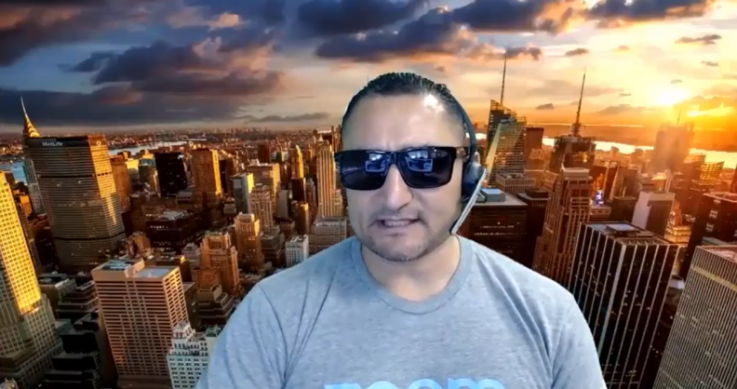
BEFORE THE INTERVIEW
Settings

Slide 5
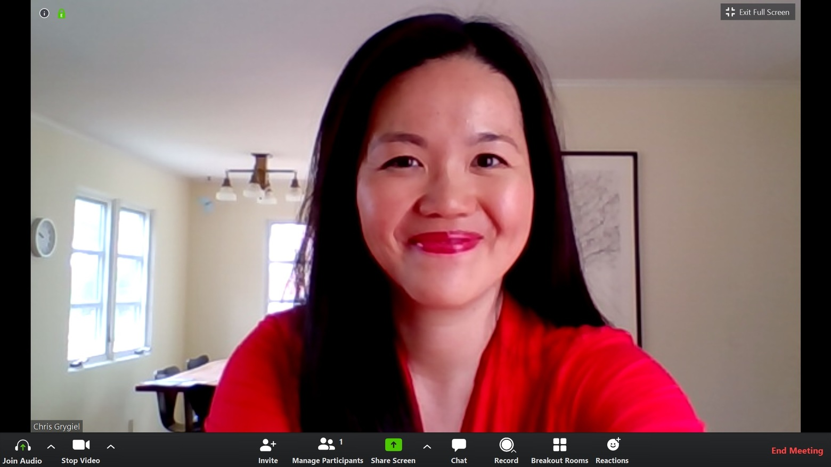
Setting
Background
Video
Audio
Internet
Potential distractions
Have some water!

Slide 6
BEFORE THE INTERVIEW
The academic job conundrum (skills to get to the interview, get the offer, and then succeed in the job are different)
Job hunt can be a full-time job
Study the job description (split, specific areas, etc.)
Get information on the search committee (try to put yourself in their shoes)

Slide 7
BEFORE THE INTERVIEW
The search committee (The Usual Suspects)

Slide 8
BEFORE THE INTERVIEW
Get information on the department
Be yourself, but be strategic!
Watch other interviews!
https://calendar.hr.ufl.edu/events/category/talent-acquisition-and-onboarding/search-committee-meeting/
Practice, practice, practice! (Record yourself and see how your answers sound!)

Slide 9
THE INTERVIEW
First round zoom interviews
Typically 1h long
Typically ~10 questions (each question has a purpose)
60 min – 5 min intro = 55 min/10 = 5.5 min per question
Final round zoom interviews
Different ball game!
Can last 2-3 days
Research seminar, teaching demonstration, group meetings, students, Chair, Deans, etc.

Slide 10
THE INTERVIEW
Why are you interested in this position and why are you interested in leaving your current position?
It’s ok to talk about your ambitions and what you want to accomplish, but keep in mind that is more about “them” than you! (What would you bring to the table? How can you make the Dept. better?
Don’t be too negative or critical about your current position

Slide 11
THE INTERVIEW
Please briefly summarize your current research project(s).

Slide 12
THE INTERVIEW
Please briefly summarize your current research project(s).
Be brief! Focus on the importance of the work (don’t assume the committee knows it), the outcomes, IMPACT!
Don’t be too long, don’t be too specific or too vague!

Slide 13
THE INTERVIEW
What do you envision for your future research? What are your first 5-year goal and your long-term career goals?
“Get tenure”

Slide 14
THE INTERVIEW
What do you envision for your future research? What are your first 5-year goal and your long-term career goals?
Pre- and post-tenure
“Failing to plan is planning to fail.”
Be bold, don’t be shy!
Be realistic with expectations (what are your future peers doing?)

Slide 15
THE INTERVIEW
How do you think your research would fit or complement current programs at UF?
Complementing others
Competing with others
It is important to convey INDEPENDENCY

Slide 16
THE INTERVIEW
What do you think are the most important attributes of a successful faculty member?
Do you understand the job?
Productivity, focus, prioritizing, multi-tasking, communication, persuasion, collaborations, problem-solving, leadership

Slide 17
THE INTERVIEW
How do you approach mentoring undergraduate and graduate students?
“I think grad students need to suffer…”

Slide 18
THE INTERVIEW
How do you approach mentoring undergraduate and graduate students?
You need a mentoring plan!
What is your philosophy?
What is your experience?
How are you going to recruit and lead a team?
Approach: Examples can be great!
Show compassion and kindness.

Slide 19
THE INTERVIEW
What do you think are your most significant accomplishments? Why?
“I haven’t achieved anything yet.”

Slide 20
THE INTERVIEW
What do you think are your most significant accomplishments? Why?
Focus on outcomes, impact!
Be genuine
Show your passion and excitement!
Don’t focus on someone else’s work!

Slide 21
THE INTERVIEW
Describe your work experiences in creating or fostering diversity and inclusion in the workplace.
“I don’t think about diversity.”

Slide 22
THE INTERVIEW
Describe your work experiences in creating or fostering diversity and inclusion in the workplace.
You need a diversity and inclusion plan!
What is your philosophy?
What is your experience?
How are you going to have diverse group? Connections are important
Approach: Examples can be great!

Slide 23
THE INTERVIEW
Tell us about your grant applications and explain three strategies you will consider for improving the chance of success.
Do you have a proven record?
Do you know the funding mechanisms?
Have you worked on a grant?
Have you taken courses/ workshops?

Slide 24
THE INTERVIEW
Do you like teaching? What is your preferred style or method of teaching?
“I like teaching, I don’t think I am good at it, but I’m willing to learn it.”

Slide 25
THE INTERVIEW
Do you like teaching? What is your preferred style or method of teaching?
You need a teaching plan!
What is your philosophy?
What is your experience?
How are you going to teach?
Approach: Examples can be great!

Slide 26
THE INTERVIEW
What courses would you like to teach at UF?
“I will have to see what’s available”

Slide 27
THE INTERVIEW
What courses would you like to teach at UF?
You need to do your homework
What courses are available?
Check out syllabus, do you have one?
What’s missing in the Dept. offerings?
What can you bring to the table?

Slide 28
THE INTERVIEW
What have you considered as a major impediment to an ideal progress in your research program?
“Funding”

Slide 29
THE INTERVIEW
What have you considered as a major impediment to an ideal progress in your research program?
Problem-solving (can also be a hypothetical question)
What problems have you encountered AND how have you solved them?

Slide 30
THE INTERVIEW
Is there anything that you would like to share that you have not been able to in other questions?
This is an opportunity to point out of emphasize any point that you judge as really important.
It is great to reiterate your enthusiasm for the position!

Slide 31
THE INTERVIEW
What leadership skills do you find most useful? How do you describe your leadership style?
Similar to mentoring question but more broad
You need a plan
You can use your own examples
You can use your mentors’ examples (good and bad)

Slide 32
THE INTERVIEW
If there was one thing that you would like to improve about yourself, what might that be?
“My accent”

Slide 33
THE INTERVIEW
If there was one thing that you would like to improve about yourself, what might that be?
Be genuine
Be honest, but don’t shoot yourself in the foot! ☺
“I wanna create less enemies” :o
“I'm constantly trying to be more considerate of others point of views”

Slide 34
THE INTERVIEW
What would you describe as your most positive attribute?
Be genuine
Be confident
Fine line between being arrogant and confident
It is great when your attributes match faculty perceptions! (and expectations for the job!)

Slide 35
THE INTERVIEW
What is a likely timeline for when you would be ready to assume the new position should it be offered to you?
When can you realistically start?
Are you a grad student, postdoc, faculty (would you bring students?), prior commitments, family, etc.

Slide 36
THE INTERVIEW
Is there anything about this position that might give you any concern?
Ideally no, but if you have, here is the time.
Another opportunity to ask questions or share something that hasn’t been shared before.

Slide 37
THE INTERVIEW
Do you have any other questions for the committee?
Yes! Many if possible! Three is a good number.
Expectations
Resources
What am I going to get? vs. What can I earn there?

Slide 38
THE INTERVIEW
Other questions:
Know your audience!
Faculty, Staff, Students, Chair, Deans
Hypothetical questions
Extension, outreach, service
Position-specific, etc.
Know your needs (facility, equipment, etc.)
Accommodation concerns? (ask the Dept. Chair)

Slide 39
Further tips:
A great response will not land you a job, but a terrible one can be a deal breaker!
It’s NOT about what YOU want!
It’s about what THEY want!
What can you bring to the table, how can you help the department be better?
Don’t ruminate on previous questions

Slide 40
Further tips II:
Don’t be too relaxed
Perception of balance (moderation)
Research/Teaching/Outreach
Be confident, but not arrogant
Be kind, polite, and respectful
Avoid mentioning your mentors too much (be independent)

Slide 41
Go get them Gators!
afaciola@ufl.edu
faciola.com

