Slide 1

2025 info session
3MT Competition
Notes:
Welcome to the 3MT info session!!
I’m glad so many students are interested in the competition. Let’s get started.

Slide 2
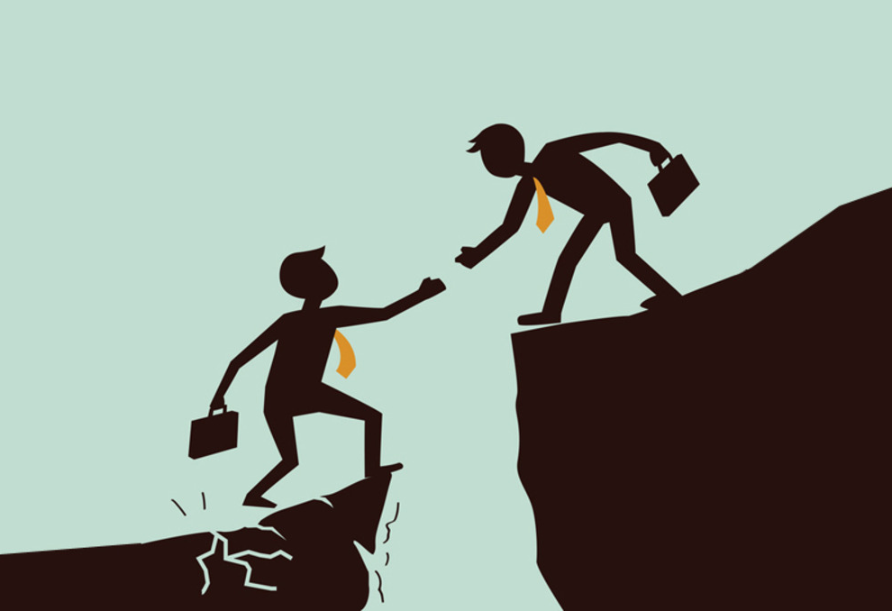
agenda
3MT Background
Important Dates
Rules / Judgment Criteria
Best Practices / Tips
Questions
Notes:
Here’s everything we’ll cover today.
First, we’ll discuss the background of the competition, how it works, etc.
Next, I’ll go over some of the important dates to remember about the competition. These can also be found on the grad school’s website.
After that, I’ll explain some of the rules for 3MT as well as the judgment criteria. This will give you a deeper sense of how the competition is structured and what things to keep in mind as you prepare for the competition.
We’ll stop for questions before moving on and covering some tips and best practices. We will look at some rules of thumb for creating a good presentation as well as a few example slides with details about the presentations which used those slides.
Then we’ll either open it up to questions or simply end depending how long it takes to get through everything.

Slide 3

background
3MT Competition:
Developed at U. Queensland
Hone presentation skills, especially for a non-specialist audience
Further builds graduate research culture
Stakes:
On top of skill building…
Monetary award for top three finalists
Opportunity to present at regional/national competitions
Notes:
Let’s start with some real background: on the competition itself and its history.
3MT was developed over a decade ago at U Queensland in Australia. The inspiration for the competition (purportedly) came from the dean of the graduate school during a period of water conservation in Australia. Citizens were encouraged to limit their showers to no more than three minutes, and… yep!
The competition is fundamentally aimed at helping graduate students talk about their work in a clear and concise way. While you probably won’t be making many three-minute presentations in your professional career, being forced to work within this constraint is beneficial for learning how to think critically about what goes into a presentation, how you should organize a talk or lecture, and so on. It is also another opportunity to create a graduate research culture at UF which isn’t restricted by departments or colleges.
All of that aside, there is also the fiscal award and the opportunity to present your work regionally and nationally (as well as accrue further awards!)

Slide 4

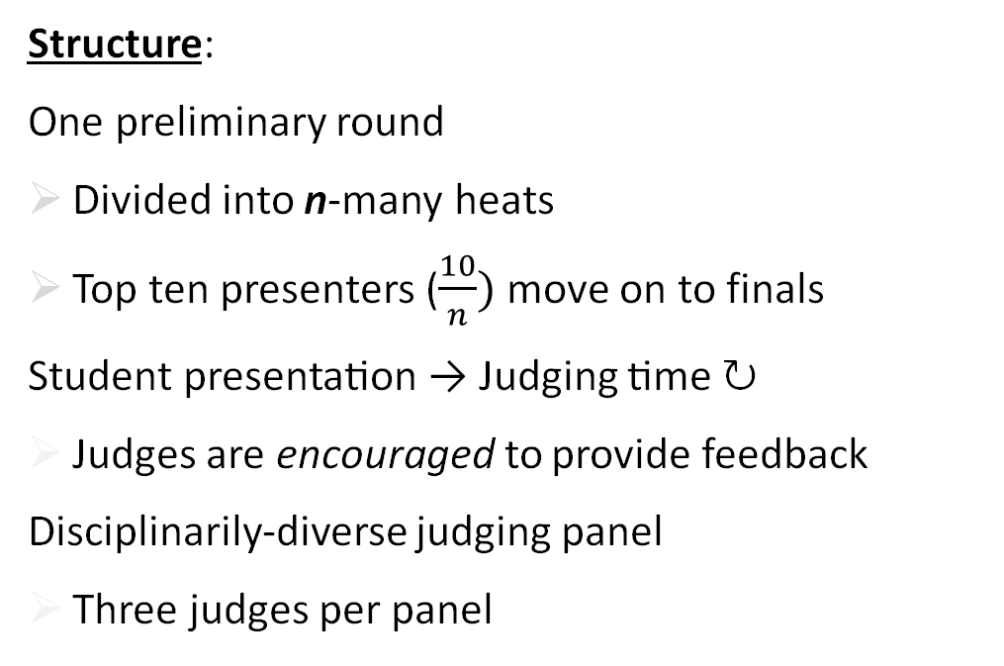
background
Structure:
One preliminary round
Divided into n-many heats
Top ten presenters ($\frac{10}{n})$ move on to finals
Student presentation → Judging time ↻
Judges are encouraged to provide feedback
Disciplinarily-diverse judging panel
Three judges per panel
Notes:
For the competition itself, we only have ONE preliminary round; we divide it into a number of heats depending on the availability of judges. This number will be between 3 and 5.
In the case that n doesn’t divide 10 evenly, we have a panel who judges across each heat and then picks the final left overs. The past few years we’ve had three heats, and that is likely how we’ll proceed this year, but I am leaving it open in case we have an especially high number of registrants.
Now, for the day of the event, there will be a brief introduction by (probably) myself where I will remind the participants and audience of the rules. After that, we will dive straight into the presentations.
I will call a student’s name, then will come to the front, I will bring up their slide, and then they will take a second before beginning (we’ll return to this when we get to the rules).
After the presentation, the judges will take several minutes to determine a score and, hopefully, provide a bit of feedback. After that, we repeat!!
The judging panels will be composed of faculty members and postdocs from a range of disciplines. We will likely have three judges per panel, and that will be divided by a humanities/social-sciences judge, a STEM judge, and a judge from CALS, medicine or another discipline.

Slide 5

background
Structure:
One final round
Slide edits can be made before finals
Reception lunch included (!)
Winners announced same day
Notes:
BTW, this is an image that came up when I searched “final round”, and I thought it was so surprising that I needed to include it.
There will be one final round, two weeks after the preliminaries. The judges will be different from those in the preliminaries, the audience will be larger and more diverse, and there will be more stage-setting (welcome remarks from one of the deans, a more formal room setup, and so on).
Finalists will have the opportunity to make edits to their slides before the finals. If the preliminary judges provide written feedback (as I hope they do), they may offer suggestions on this front. Members of the audience may also provide some informal feedback to inform any changes you may make.
The finals will also include a luncheon (food!!) for the finalists. This will be a nice opportunity to chat with some faculty outside of your department about your research, or to brag to upper administration about your high-quality research (they will be very interested, if past competitions are anything to go on).
We will also announce the three winners after lunch, hand out trophies, and celebrate as a community.

Slide 6
Important dates
DATE | EVENT
July 18 | Registration opened
October 6 | Registration closes
October 9 | Preliminary round slides due
October 23 | Preliminary round; finalists announced
November 3 | 3MT Finals slides due
November 6 | 3MT Finals
Notes:
Now, important dates!
July 18th has already come and gone, and you should have already heard, but registration for the competition is now open!
Registration will close on October 6th. That is a hard deadline, since there is a lot of busy work going on behind the scenes between then and the preliminary round.
Soon after registration closes, you will be expected to submit your 3MT slide. If you fail to submit your slide by the end of the day on October 9th, you will be excluded from the competition.
October 23rd is our preliminary round! I will also announce our finalists that evening (or the next morning… Sometimes I am slow!).
If you are chosen as a finalist, revision to your slides will be due by November 3rd (end of day).
And the final competition itself will occur on November 6th!
You will be able to find these dates on the Graduate School’s 3MT website as well.

Slide 7
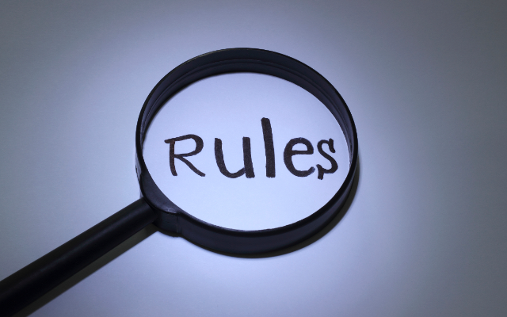
3MT RULES
Presentation Rules:
Speakers cannot exceed three minutes of speech time
Presenters surpassing three minutes are disqualified
Speakers must use spoken word
E.g., no poems, songs, recordings
The three-minute timer begins once the speakers starts their presentation through word or movement
Coming to the front of the room does not start the timer

Slide 8

3MT RULES
Add’l Rules:
A single slide is required and is to be presented at the beginning of oration
No slide animations (incl. gifs), transitions, or movements
Additional electronic media (sounds, videos) are forbidden
Additional props (lab equipment, costumes, instruments, and so on) are forbidden
The decision of the adjudication panel is final.

Slide 9
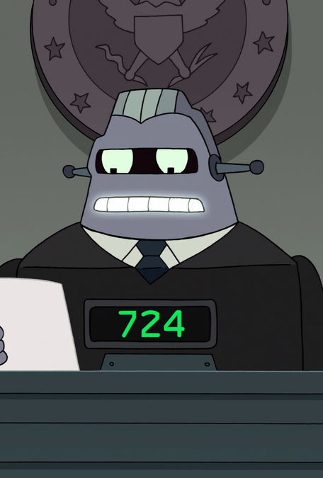
Judgment criteria
Comprehension & Content:
Presentation provided clear motivation, background, and significance to the research question
Presentation clearly described the research strategy/design and the results/findings of the research
Presentation clearly describes the conclusions, outcomes, and impact of the research

Slide 10
Judgment criteria
Engagement & Communication:
The oration was delivered clearly, and the language was appropriate for a non-specialist audience
The PowerPoint slide was well-defined and enhanced the presentation
The presenter conveyed enthusiasm for their research and captured and maintained the audience’s attention

Slide 11
QUESTIONS?
Before we move on…
Notes:
Does anyone have any questions before I move on to discuss tips and best practices?
Let’s look at some tips and best practices for your 3MT presentations. We’ll look at a few tips and then an example from a 3MT winner that demonstrates at least some of it

Slide 12

Basic Tips & best practices
Avoid technical jargon
To an audience of folk outside your discipline, you are trying to convey your 80k word dissertation in three minutes
Explain (or at least describe) the central persons or ideas in your research
Often a dissertation is built around a central idea: ensure the audience knows about the idea
Leave the audience with a surprising or exciting conclusion
A good ending goes a long way
Notes:
Using too much technical jargon is one of the biggest pitfalls for 3MT competitors. It is incredibly easy to fall into using technical terminology during your presentation, since you’re so accustomed to using it while working on your project! But you need to fight that instinct.
Very frequently a dissertation is built around a topic (for example, by developing a novel approach to explaining some phenomenon). You need to be sure that the audience has a sense of that topic. In my case, I was developing a new approach to a topic in contemporary philosophy: theoretical rationality. It’s true that people have a rough sense of what “rationality” is, but being precise here is important.
At the end of the day, you’re doing something akin to giving an elevator pitch. Not only do you want to convey that your research is important, but you want the audience to leave with a sense of “oh yeah that IS interesting!” We’ll come back to this point.
Let’s look at an example.

Slide 13
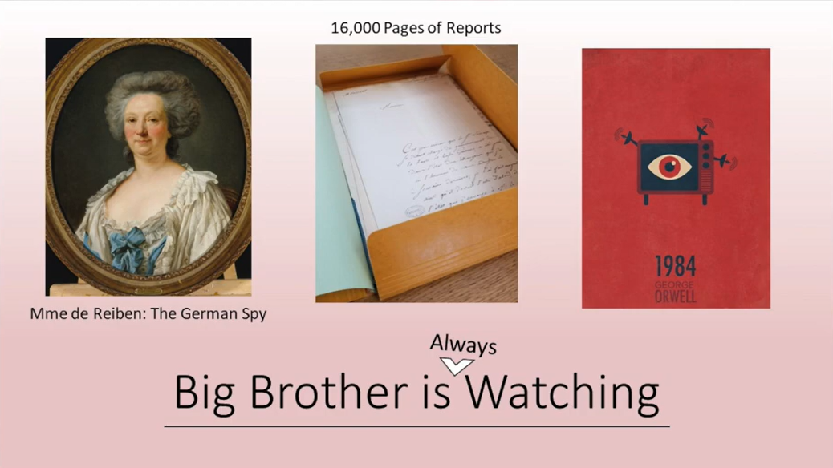
Notes:
Thesis title: “City of Spies”
Here we have a thesis about the history of spying, that is, of the government listening to what its citizens and guests are saying.
This slide is free of technical jargon. There is no overuse of symbolic notation (which may mean different things to different people), there is no oblique graph with unclear axes, and so on. The same is true for the verbal potion of the presentation.
While it lacks technical jargon, it does reference someone with whom you have no familiarity (if you’re like me and the dozen-or-so people I showed this to, at least). Not only does the slide at least say something about who this person was (a german spy), the presentation also uses this person to frame their thesis: the situation surrounding this historical figure is (according to the presenter) the first case of mass surveillance.
This also transitions to a takeaway, since one of the major upshots of their dissertation is that mass surveillance has been a problem from FAR earlier than most folk realize (two centuries earlier). Not only does this have a surprise effect on its own, but it also allows the presenter to conclude with a reference to one of the best examples of mass surveillance (the big bother program in Orwell’s 1984) as well as a contemporary reality show and highlighting that the problem ain’t new (it’s ALWAYS watching, and doesn’t need contemporary technology to do it!).
The second image on this slide also exemplifies what is another good tip: make your methodology clear!!
And overall, this slide does something important: it is personal (not cookie-cutter, hackneyed, or overly-engineered), and the audience responds well to personal.

Slide 14
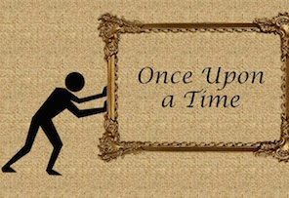
More tips
Make your methodology understandable (but not dense)
Your data collection, research methodology, etc., is important to your project
Tell a story and make a narrative
This is true for academic writing and presenting generally (think about narrative structures)
Remember: less is more
For your slide, strive for simplicity and cut with Ockham’s Razor
Notes:
Another thing that the previous slide did well is hint at its methodology: the student discovered thousands of pages of reports about surveillance in France and Germany. This not only informed his example/framing, but it explains how his research is justified! This step is much easier for some disciplines than others. For the sciences, while it may be easy to overuse technical jargon, most people have a good sense of the scientific method, so the discussion of data collection at all is easily grasped by an audience. In our next example, we’ll see a situation where that could go awry.
One of the best ways to communicate your ideas is by framing them as stories or narratives. This does not mean that you should be weaving a tale using literary devices or dense metaphors, but you should structure your presentation like a story. A simple way to do this is by thinking of a presentation in traditional screenwriting terms: use a three-act structure. First, introduce the problem or topic that your dissertation is about (a concrete example goes a long way here). Second, get to the part of the problem that you’re solving or the new thing you’ve discovered or developed, and say something about how you’re solving it or how you discovered it. (Think about this like act 2 in a film: it tends to be the low point, where some problem occurs and a path towards a solution is forged.) Third, you talk about how your solution solves the problem (and why it matters) or you describe how your discovery informs us on something in your discipline (or some other meaningful implication).
Lastly, remember that less is more when it comes to slides. We saw this in the previous slide, and we’ll see it again in the next slide.

Slide 15
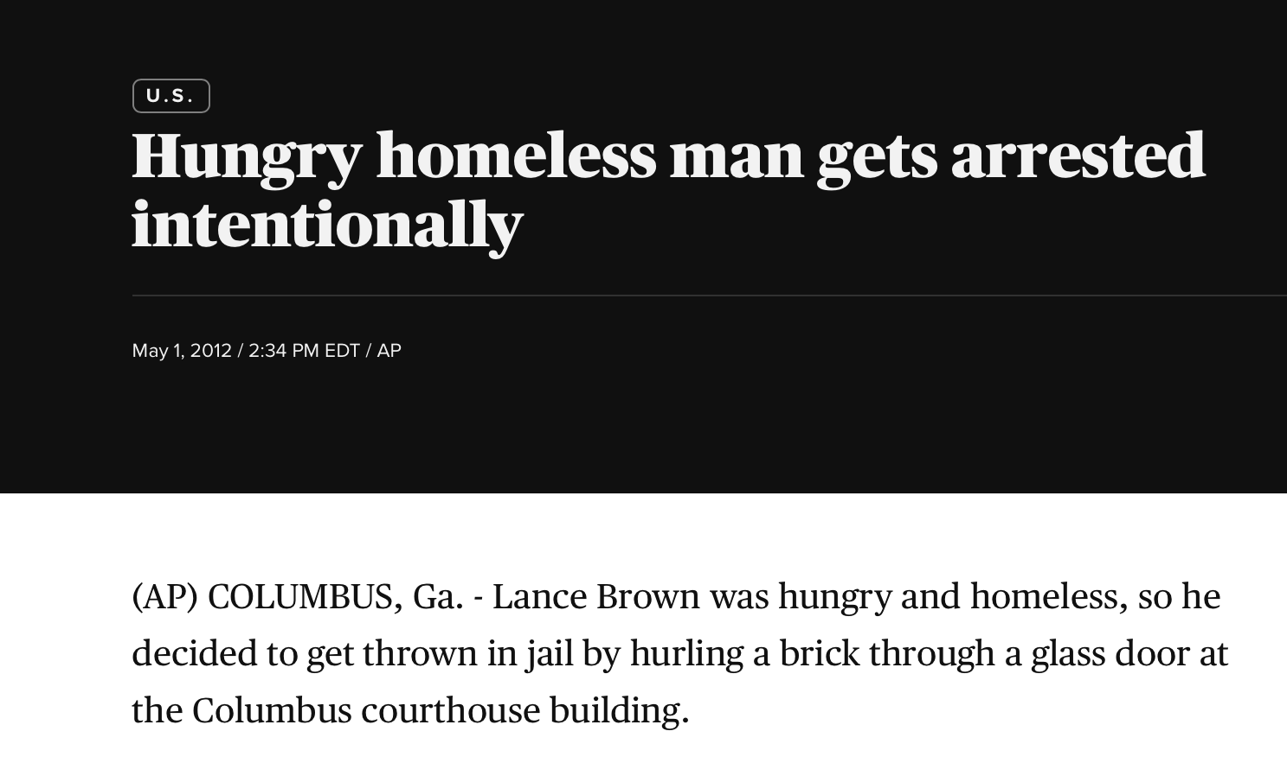
Notes:
Here is a winning slide from UF’s 3MT competition. This is such a simple slide: a screenshot of a news headline, and its simplicity is flashy, which makes the audience curious and engaged.
The slide also gives us the narrative framing for the presentation straightaway. We have an example (this man, Lance Brown), a phenomenon/problem (the presenter called this “Gaming The System”—using established rules/systems in unintended ways to get some desirable result), and we’re OFF! The presenter used this example to introduce the phenomenon that his dissertation is trying to explain (“Gaming the System”) as well as the puzzle about that phenomenon that he’s trying to solve (when, if ever, this kind of behavior is morally good/bad, and how we can evaluate such behavior in a principled way). After the presenter proposes their explanation for this phenomenon, he transitioned to the final act of the presentation: how this result is important/useful and why it matters).
One area where this presentation is a bit weak is in the methodology section (and, to a lesser degree, the final section). This is a philosophy dissertation, and the methodology of philosophy, while not necessarily difficult to describe, is not always received by a non-specialist audience as legitimate. (This is misguided, of course; the philosophical method is, in almost every way, the scientific method, but the data/evidence has a different shape.) This also makes the value of the conclusion/consequences a bit hard to grasp for some listeners. Some struggle to see the value in being able to think clearly about a phenomenon that has social import (so many people take advantage of systems to their own benefit!), so when the presenter concluded something along the lines of, “by using this framework, we will be in a position to assess those that game the system and know whether and when we ourselves should be more like Lance Brown.” But that IS a good conclusion narratively, for it ties together the presentation while making very explicit his conclusion.

Slide 16
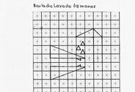
Final tips
Imagine that you’re presenting this work to a friend or student from another discipline
From the start, have an idea of what the audience should take away
This takeaway isn’t just “my research!”, but something especially powerful about it
Make your slide legible and clear
If there’s some info you want on your slide but cannot fit without sacrificing legibility/clarity, cut
Notes:
A solid piece of practical advice is to imagine you’re writing a presentation to a friend or—perhaps better—a student from another discipline. Think about the things they know, the things they probably know (or can infer on their own), and the things they definitely need to know to understand your work. Peers can follow reasoning and understand arguments/evidential support, but they cannot always understand your project without other information.
We’ve already covered that your presentation should have an exciting or surprising conclusion. (In the last slide, the excitement was maybe a bit unclear; in the first slide, the result was a bit surprising. In the next example, we’ll see both!) We’ve also seen that having a narrative structure to your presentation is beneficial and appealing to an audience. There’s a way of giving a presentation which just states your research and the expectation is for the audience to leave with *that*. You want to plan so that the audience leaves with something lingering in their heart or brain, like a good film or powerful novel. You won’t be able to do that to the degree of a novel or film, but that is the kind of takeaway I mean.
Just make sure your slide looks nothing like that image. Please.

Slide 17
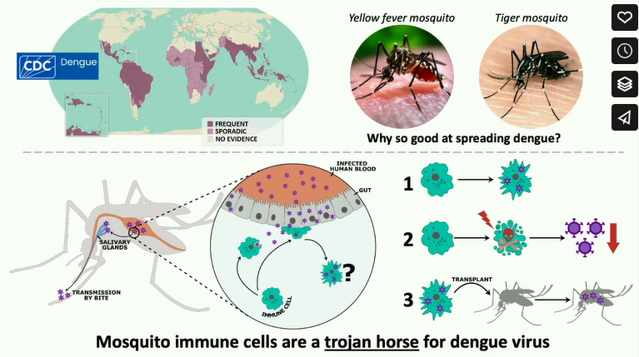
Notes:
Ignore the Vimeo buttons on the screen. I needed to screenshot this.
Here we have a slide that brings a lot of lessons together. While the slide is busy and has a lot of pieces, it isn’t so complicated (with graphs, technical terms, etc) that you are wondering “what does this mean?’ while listening.
The presentation also opens in a gripping way: “Today I’m going to talk about the world’s deadliest animal…. The mosquito.” The reason that works so well is that it subverts our expectations some and gets us interested. (Many people know how deadly mosquitoes can be, but it is still a good opening gambit.) And by further clarifying that it isn’t even the mosquito itself, but what the mosquito carries, we get another layer to this: the dengue virus, which immediately tells us what that info on the slides means. Great opening!
The slide is also used as a reference point: it isn’t filling in details that the speaker can’t cover in three minutes. The first image shows us how deadly the dengue virus is (and the speaker gestures to it when he mentions the deadly nature of dengue), and the second image just gives us a visual for which mosquitoes in particular carry the virus. The speakers told us who they are and why they matter, and the slide is only a visual reference to them and what the problem is: we don’t quite understand why they’re so good at spreading dengue virus.
Once the speaker states that we are after an explanation for how the virus travels to the mosquito’s mouth to bite, we encounter the result: the virus cells travel through the mosquito through its immune cells. Pointing out a counter-intuitive result is always good, for it shows that your research has given us a very noteworthy consequence. Hearing that immune cells are esponsible for transmitting one of the deadliest viruses is exciting even for a non-expert (perhaps especially for a non-expert!).
The speaker explains how this works by gesturing to the final set of images on the slide (the 1-2-3). He explains “first, the immune cell becomes infected”; second, by killing the immune cells, the mosquito itself loses the virus (or it slows down the virus in the mosquito so it doesn’t reach its mouth to bite/transmit), where this is another surprising result; third, when we take the infected immune cell and place it in a non-infected mosquito.. It gets the virus!!
This finally ties everything together. Rather than the immune cell being that which protects the mosquito from this virus (the thing we’d expect), we learn that the mosquito is so deadly because its immune feature is in fact a trojan horse for dengue! The consequences here are easy to explain (helping us understand something deadly), but—and here is how the narrative comes together—helping us understand how the deadliest animal is so deadly. The speaker explains the obvious consequences (helping us treat a deadly disease), then adds “but from a more basic perspective” we get to learn how insects can be SO good at doing this, and how we can make the deadliest animal a bit less deadly. This is GOOD!

Slide 18
QUESTIONS?
Before we move end…
Notes:
Who has final questions?

